Slide 1

DriverPass System Analysis
Derricko Swink
Notes:
[No speaker notes required for this slide.]

Slide 2

System Requirements
Functional Requirements:
User Registration & Authentication: The system allows DriverPass' students to register, create an account, and log into their accounts using their credentials. It will also validate the validate the credentials during the login process.
Appointment Scheduling: The system will allow students to schedule driving lessons with available instructors and provide notifications for upcoming appointments.
Nonfunctional Requirements:
Scalability: The system will support future expansion, allowing the addition of more users and functionalities (such as new service packages) without requiring major architectural changes.
Security: The system will implement robust security measures, including data encryption and two-factor authentication, to protect user data and prevent unauthorized access.
Notes:
[In your speaker notes, include an explanation of the different requirements you determined for DriverPass’s system. What are the functional requirements you selected to describe? What are the nonfunctional requirements you selected to describe? Be sure to explain how these requirements meet DriverPass’s needs.]

Slide 3
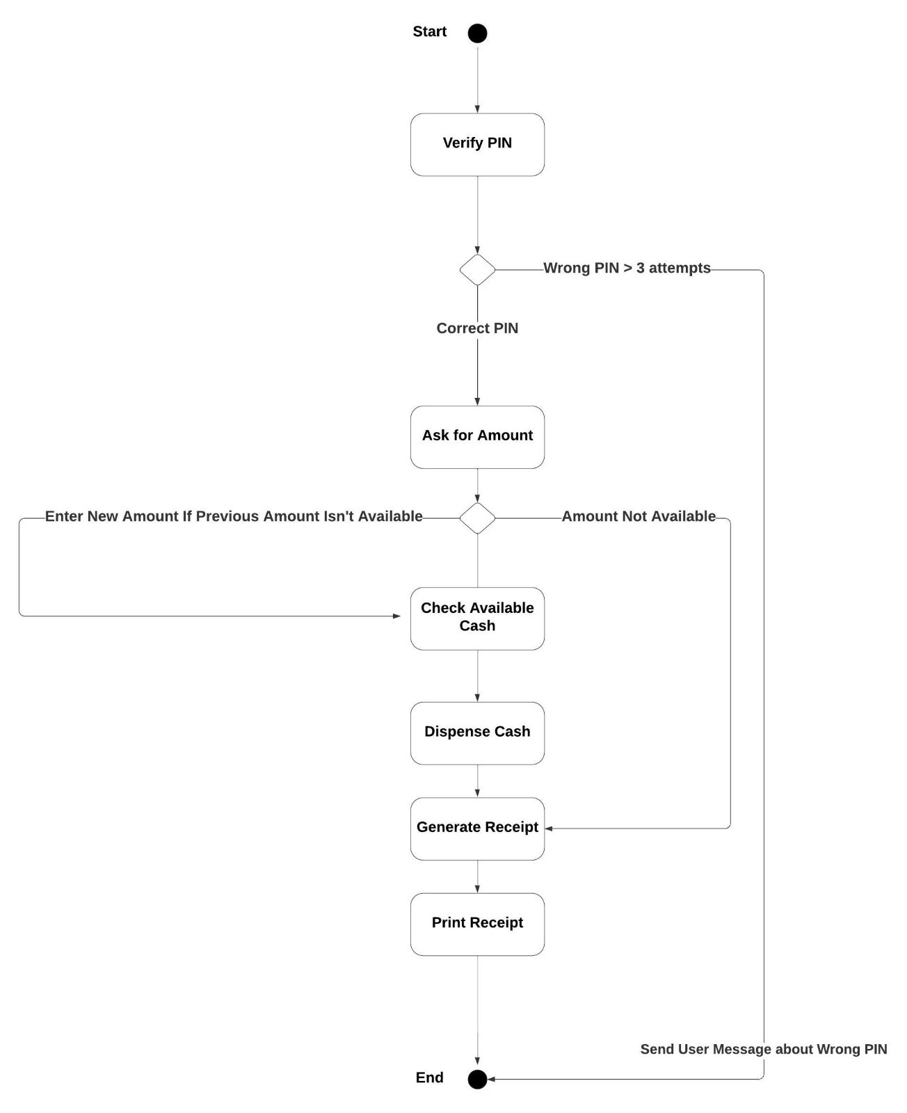
Use Case Diagram
Notes:
[Explain your diagram. Who are the different actors in the system? What are the different use cases? How did you account for DriverPass’s needs in your design? In your explanation, keep your audience in mind. Avoid the use of terms like “actors” and “use cases” in your explanation.]

Slide 4
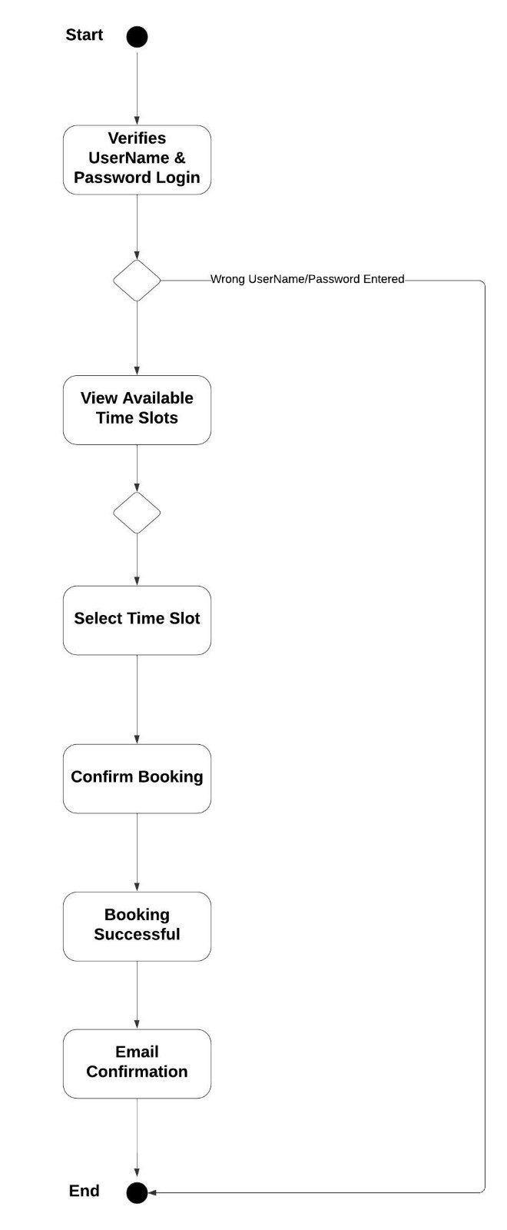
Activity Diagram
Notes:
[Explain your diagram. Which use case are you breaking down? What are the steps for this use case? How did you account for DriverPass’s needs in your design? In your explanation, keep your audience in mind. Avoid the use of technical terms such as “nodes,” “control flows,” and so on.]

Slide 5
Security
User Authentication: Implements a secure login system to verify user credentials, ensuring that only authorized individuals access sensitive features.
Data Encryption: Uses encryption techniques for secure data transfer, protecting user data such as personal information and payment details.
Role-based Access Control: Limits system access based on user roles (Student, Secretary, IT Officer), reducing the risk of unauthorized actions or data exposure.
Audit Logs: Tracks and monitors system activities, allowing for the detection and investigation of any suspicious or unauthorized behavior.
Brute Force Protection: Includes mechanisms to lock accounts after multiple failed login attempts, reducing the risk of brute force attacks.
Data Privacy Compliance: Ensures compliance with data protection regulations, protecting user information and privacy.
Notes:
[How did you consider security in your design? In your explanation, keep your audience in mind by avoiding the use of technical terms.]

Slide 6
System Limitations
Scalability Constraints: The system may face challenges in handling a large number of users simultaneously without performance degradation, particularly during peak times.
Platform Dependency: Limited compatibility with certain platforms (such as mobile or specific operating systems), restricting user access from all potential devices.
Resource Intensive: High hardware requirements for optimal performance may limit access for users with older or lower-spec devices.
Third-Party Integration Risks: Dependence on external systems (for example, DMV integration) may introduce latency or failure points outside of the system’s control.
Maintenance Overhead: Frequent software updates and patches may require significant time and resources to keep the system running smoothly and securely.
Limited Customization: Users may have restricted ability to personalize the interface or workflows, which might affect user experience and adoption rates.
Notes:
[What are the limitations of your design? In your explanation, keep your audience in mind by avoiding the use of technical terms.]

Slide 7
System Features & Benefits
To recap, the DriverPass system is designed with both current needs and future growth in mind. It offers a secure, scalable architecture that can adapt as DriverPass expands.
Key functionalities include student registration, scheduling, and tracking, all integrated seamlessly with external systems like the DMV.
Our reporting features will support informed decision-making, while the system's emphasis on security ensures that sensitive data is protected.
Flexibility is built in, allowing customizable service packages as needed. Lastly, administrative tools allow for proper system maintenance and oversight, ensuring a smooth, efficient operation now and in the future.
Notes:
[What are the limitations of your design? In your explanation, keep your audience in mind by avoiding the use of technical terms.]

Slide 8
Future Growth & Scalability
Enhanced scalability for expanding DriverPass services to new regions.
Ability to introduce new features like virtual driving simulations, additional practice test formats, and more.
Seamless integration of new third-party systems (for example, insurance verification) as needed for expanding functionality.
Increased automation in scheduling, reporting, and communication to streamline administrative tasks.
Data analytics and reporting features to track student performance trends and improve teaching methods.
Continuous improvement with periodic updates to meet evolving security standards and user expectations.
Notes:
[What are the limitations of your design? In your explanation, keep your audience in mind by avoiding the use of technical terms.]

